Slide 1


Harnessing-Data-Analytics-for-Sustainable-Investment-Strategies
Team Members: College :
1.Arun Kumar (Team Lead). Kalaignarkarunanidhi
2.Mouli hariharan Institute ofTechnology.
3.Lalith Kumar Coimbatore.

Slide 2
Goal of our Project :
To predict the sustainable investment companies using data analytics and streamlit application .
Software Used :
1.Vs-code.
2.Github.
3.Streamlit.

Slide 3
PROJECT OVERVIEW:
Data Cleaning.
Visualization.
Data Preprocessing.
Model Selection.
Streamlit.

Slide 4
Data Cleaning :
i)Information of a dataset
Info() :
It gives the complete information about the dataset.
For example – Datatype, Count of null values etc…,
This dataset has no null values ,so there is no need is to change any NA value.

Slide 5
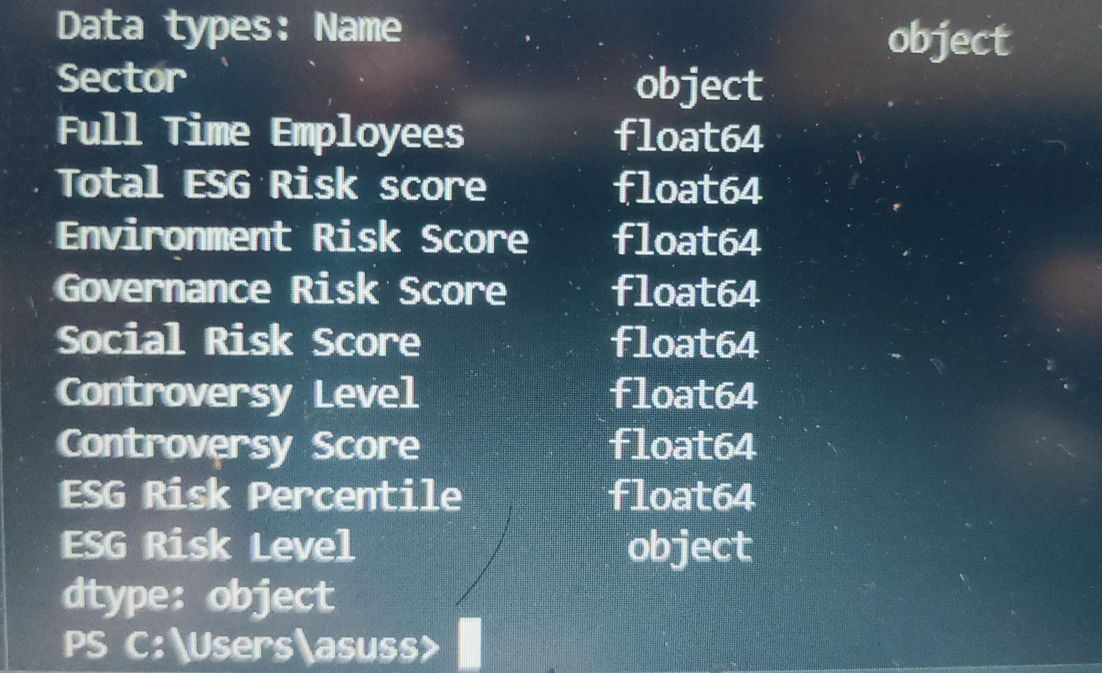
Code for getting datatype() :

Slide 6
ii) Droping unwanted columns:
This process is used to filter the wanted column that are required for modeling process.
Here the unwanted columns are –
1. HasConterversy
2. Description
TARGET VARIABLE : Names

Slide 7
Model Selection
Decision trees are a type of supervised machine learning algorithm that can be used for both classification and regression tasks. They are relatively simple to understand and interpret, and they can be effective even with small datasets.
Decision trees can handle both categorical and numerical data without requiring any preprocessing. This is helpful for this data, which includes both numerical features (e.g., ESG risk scores) and categorical features (e.g., sector).

Slide 8
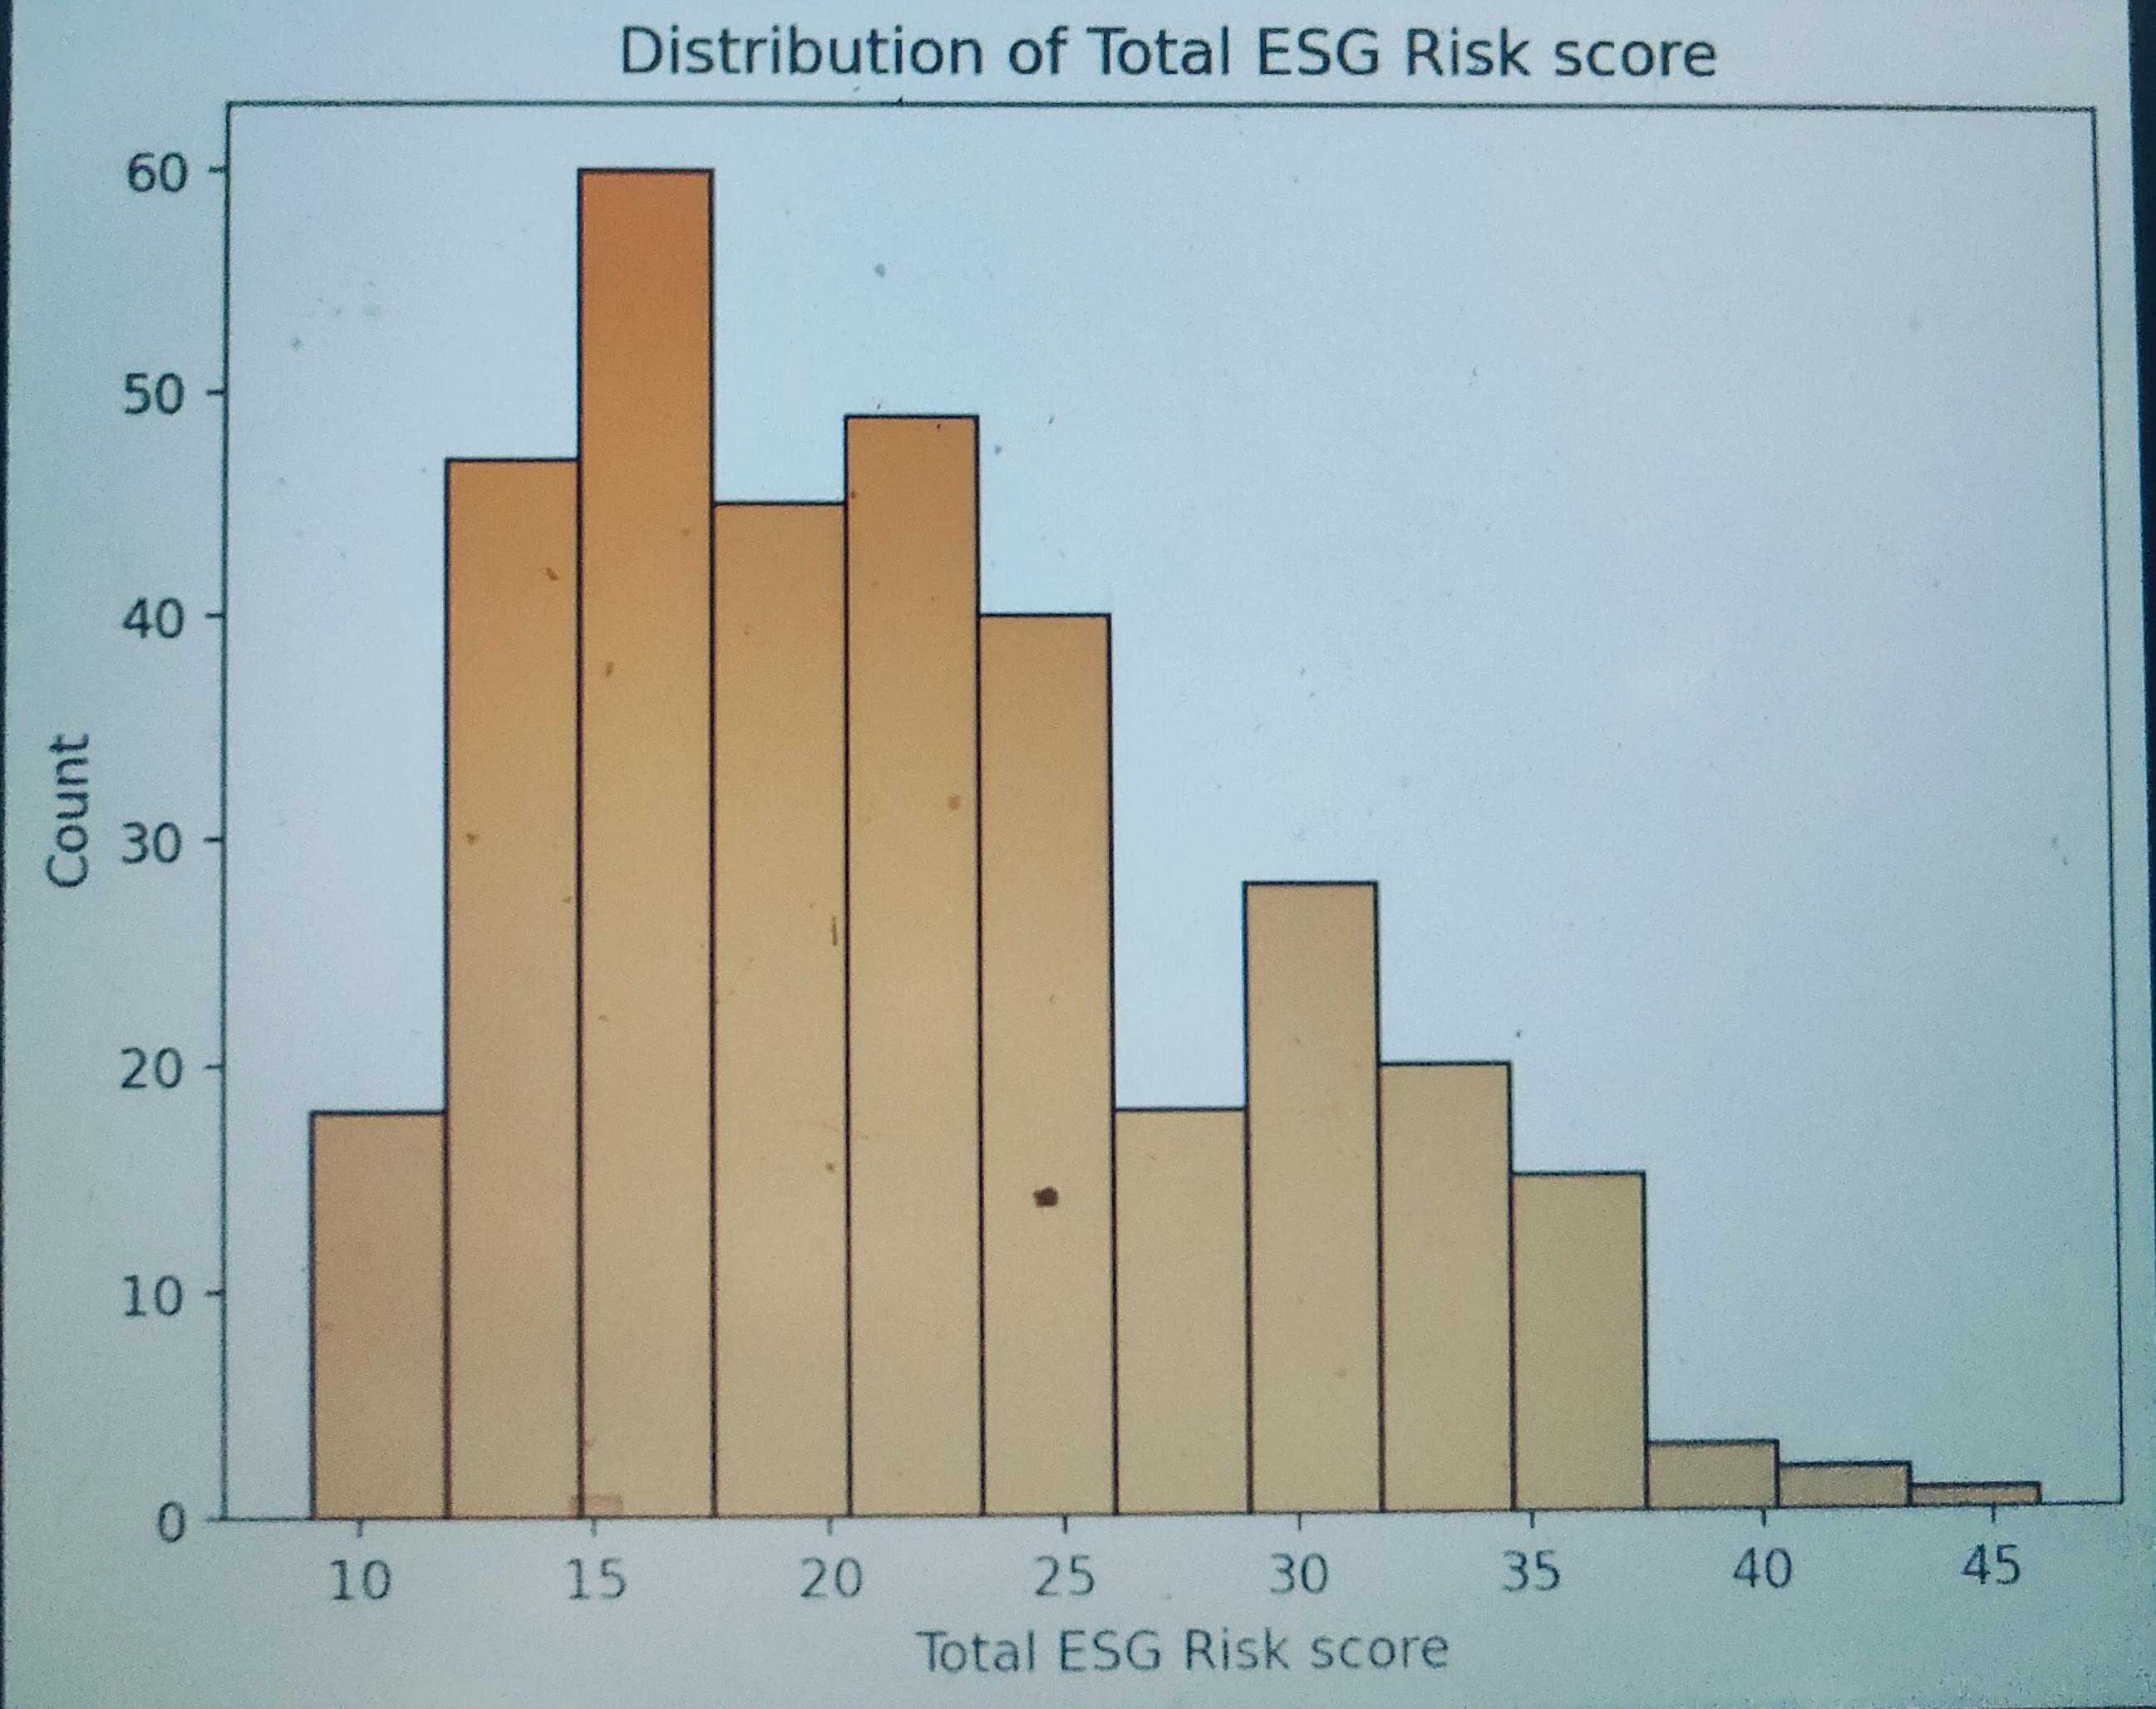
Visualization.
It’s the graphical representation of data or information.
i) Total ESG Risk Score:

Slide 9
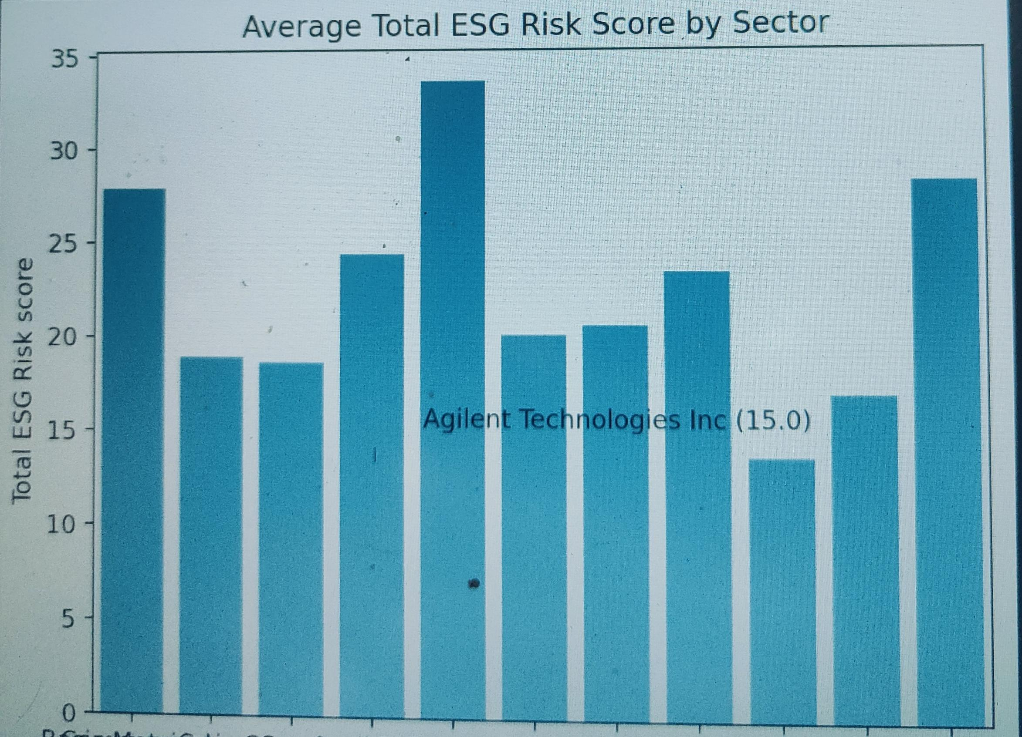
ii)Total ESG Risk Score

Slide 10
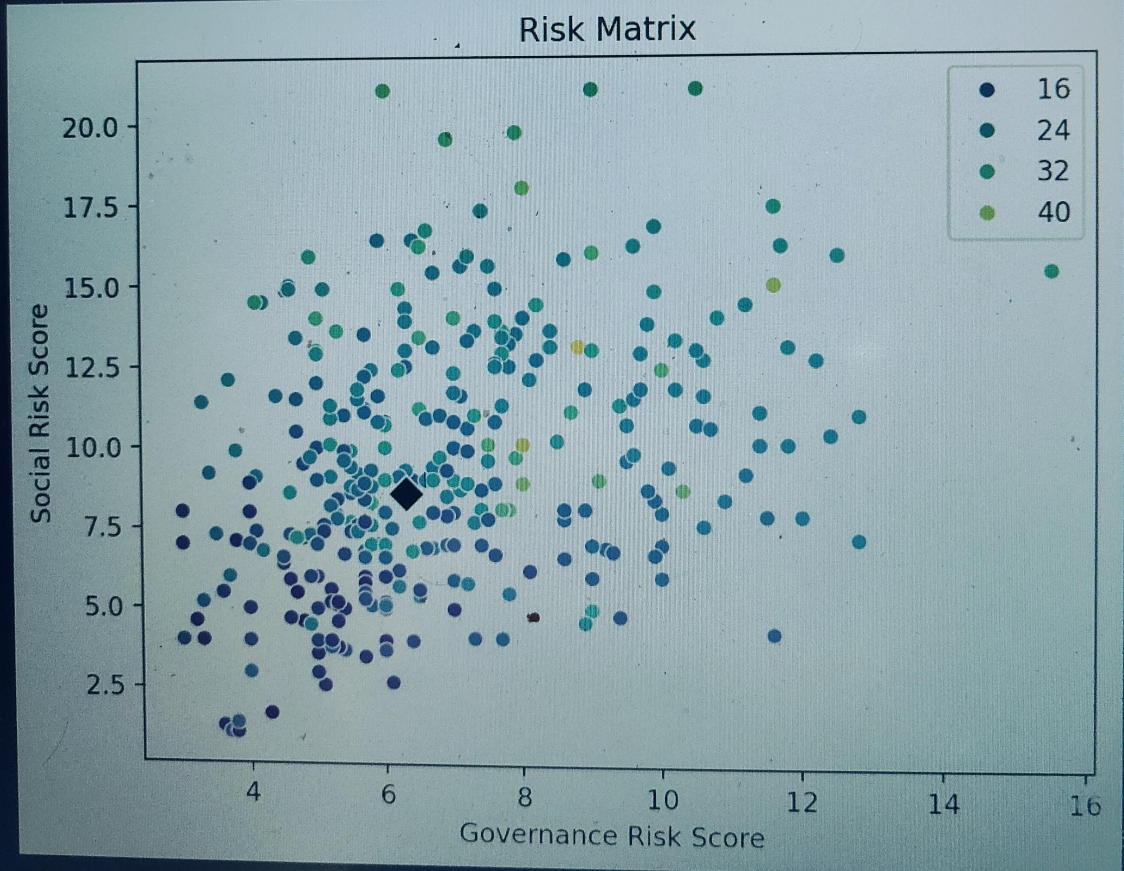
Risk Matrix

Slide 11
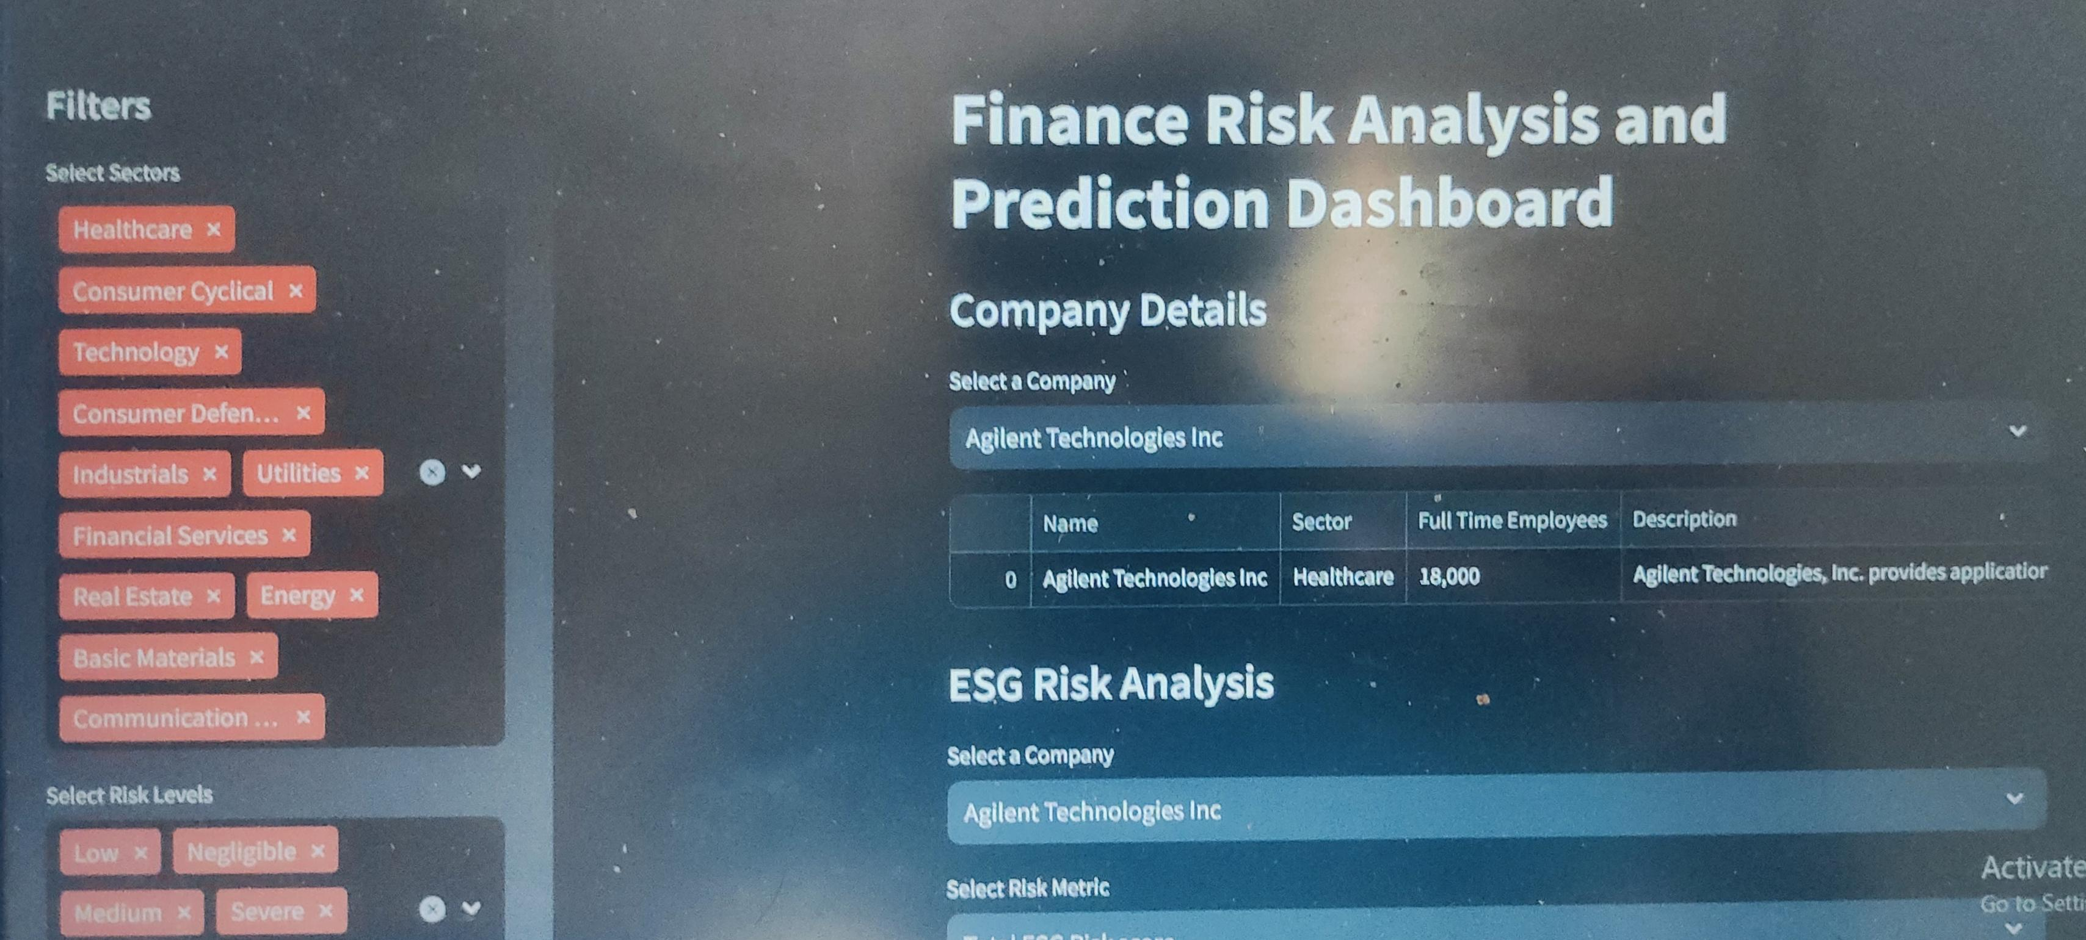
Streamlit:

Slide 12
THANK YOU

